Slide 1
Review on Molecular Biology-1
Md Mazedul Haq
haqmazed@jbnu.ac.kr

Slide 2
Learning Objectives
Immune System
Enzymes
Biosynthesis of Biomolecules

Slide 3
Immune System

Slide 4
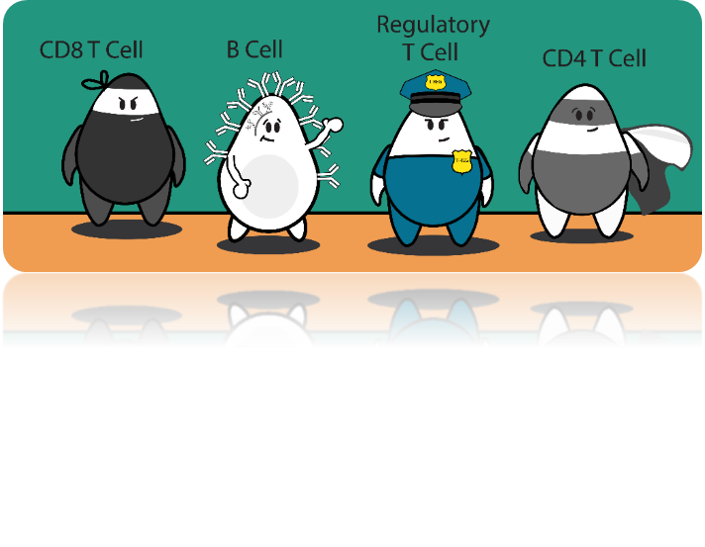
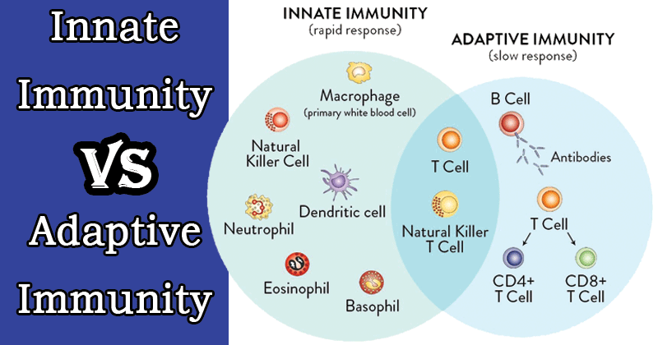
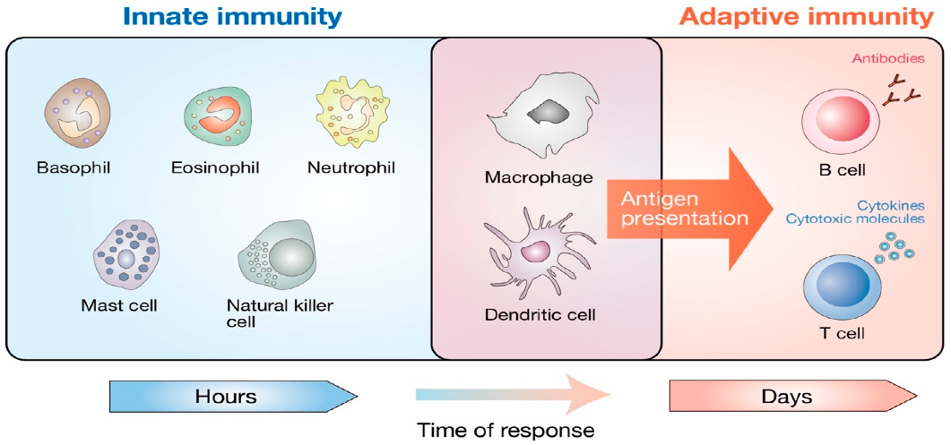
Immunity
Innate immunity: Defenses against any pathogen
Adaptive immunity: Induced resistance to a specific pathogen
Q. Which immune responses at the very beginning of an infection?

Slide 5
THE INNATE IMMUNE SYSTEM
First line of defense against pathogens
Physical Barriers
Skin-sweat
Mucous membrane-saliva, tears, mucus
Urine
Components
Complement system
Macrophages and neutrophils
Defensins
Coagulation system
Cytokines and inflammatory cytokines
Inflammatory response
Natural killer cells

Slide 6
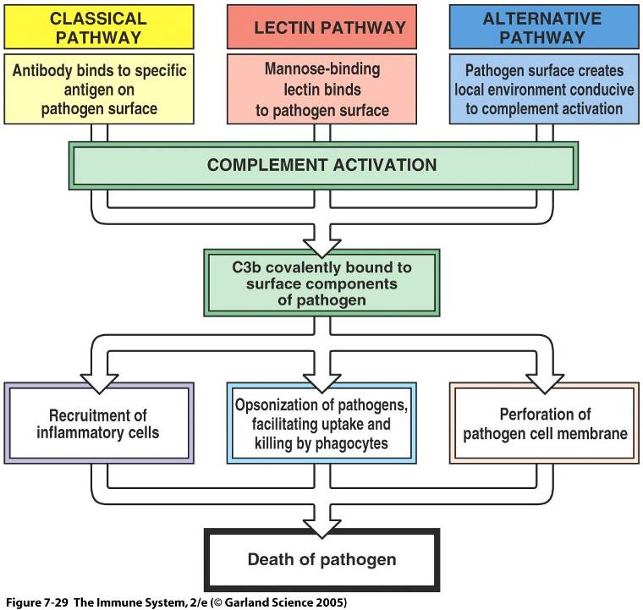
Complement System Activation

Slide 7
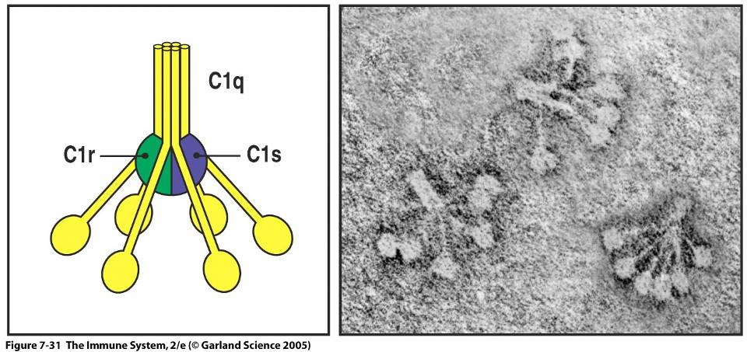
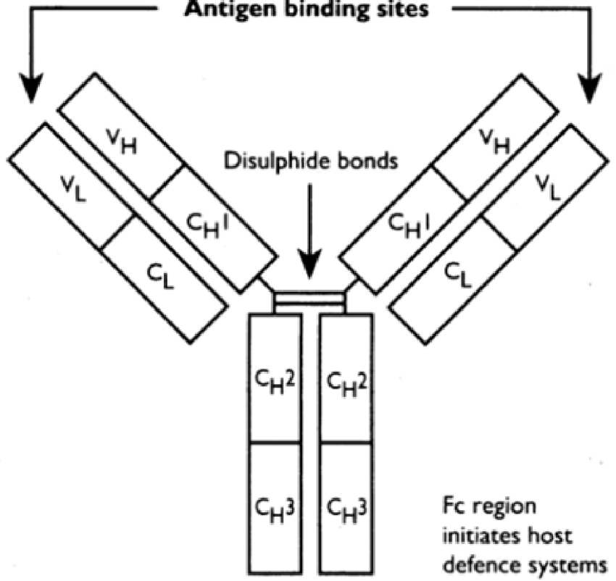
CLASSIC PATHWAY OF COMPLEMENT ACTIVATION
C1 binds to Fc region of antibody part of Ab/Ag complex
C1 is complex of 3 proteins
C1q is binding protein
C1r and C1s are proteases
C1q binds to Fc region of antibody which activates
C1r which activates C1s
Most efficient at activating complement
IgM, IgG1 and IgG3

Slide 8
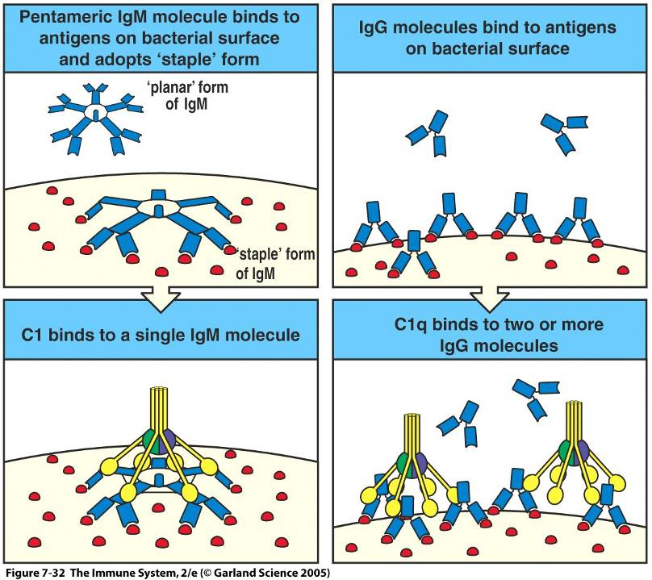

Slide 9
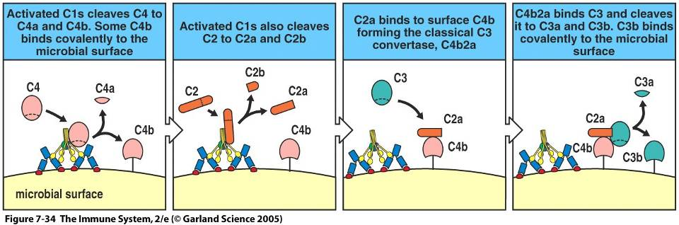
CLASSIC PATHWAY OF COMPLEMENT ACTIVATION
Activated C1s cleaves C4 to
C4a and C4b
Activated C1s cleaves C2 to
C2a and C2b
C4b and C2b form complex covalently bonded to pathogen surface
C4b/C2b complex (C3 convertase) cleaves C3 to
C3a and C3b

Slide 10
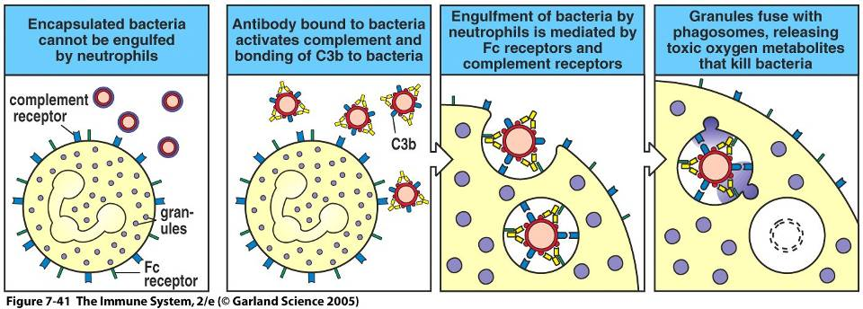
ANTIBODY AND COMPLEMENT ENHANCE PHAGOCYTOSIS

Slide 11
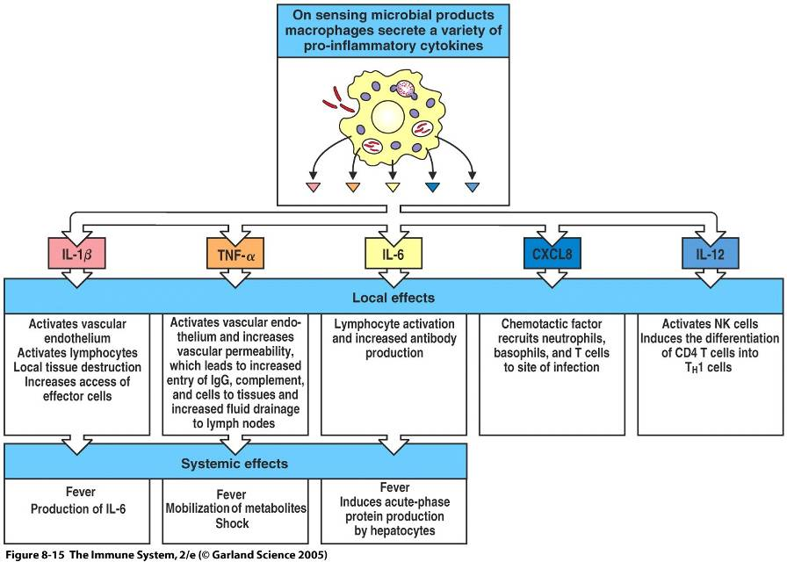
ACTIVATION OF MACROPHAGES
Cytokines and chemokines
Interleukin-1 (IL-1), IL-6, IL-8, IL-12 and TNF-alpha (Tumor necrosis factor)
Activated macrophages secret
Cytokines
Chemokines (chemoattractant cytokines)
Inflammatory mediators
Inflammatory mediators
Prostaglandins, leukotrienes, plasminogen activator, platelet-activating factor (PAF)
Notes:
11

Slide 12
BIOLOGICAL ACTIVITY OF IL-1, IL-6 AND TNF-ALPHA
Induce hepatocytes to produce acute-phase proteins
C-reactive protein (CRP)
Mannose binding lectin (MBL)
Induce bone marrow to release neutrophils
Induce hypothalamus to raise temperature
Induce fat and muscle cells to generate heat
Notes:
12

Slide 13
DEFENSINS
Family of amphipathic antimicrobial peptides
35 to 40 amino acids
Mechanism of action
Disruption of cell membranes
Classification
Alpha
Neutrophils and Paneth cells
Beta
Epithelial cells of skin, respiratory tract and UG tract
Notes:
13

Slide 14
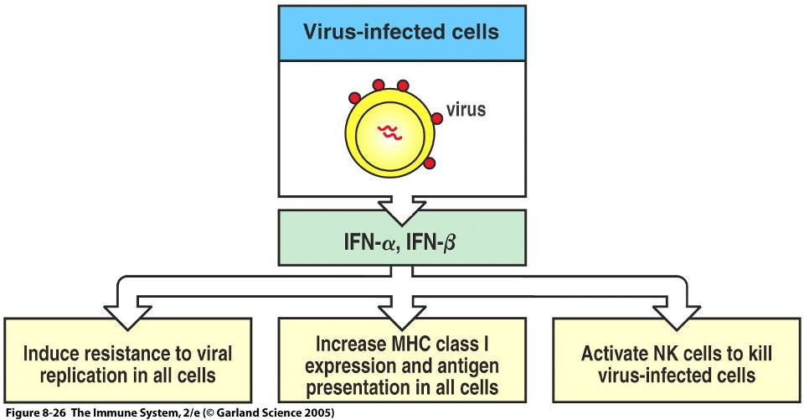
THE INNATE RESPONSE TO VIRAL PATHOGENS BY DEFENSIS
Virus infected healthy cells produce
Interferon-alpha (IFN-alpha)
Interferon-beta (IFN-beta)
IFN-alpha and IFN-beta are type 1 interferons
Type 1 interferons
Inhibit virus replication
Activate natural killer (NK) cells
Increases expression of MHC-1 molecules
Notes:
14

Slide 15
NATURAL KILLER (NK) CELLS
Large granular lymphocytes that circulate in blood
Functions
Killing infected cells (cytotoxic)
Secretion of cytokines
Activation by
Type 1 interferons
Infected cells
Stimulates cytotoxic function
IL-12 and TNF-alpha
Macrophages
Stimulates cytokine secretion
Notes:
15

Slide 16
NATURAL KILLER (NK) CELLS
Activated NK cells release IFN-gamma which activates
Macrophages
Release IL-12
Positive feedback system for NK and macrophages
NK cells provide immunity to intracellular pathogens, virus-infected and tumor cells.
Granular leukocytes destroy cells that don’t express MHC I
Notes:
16

Slide 17
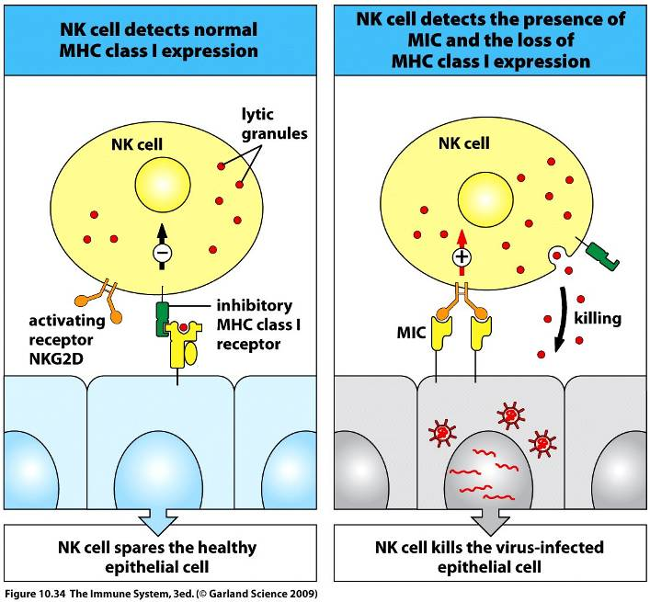
Q. How NK cells differentiate infected from uninfected cells?
NK cells express receptors for MHC class I molecules
Binding of NK cells to MHC class I molecules turn off NK cells

Slide 18
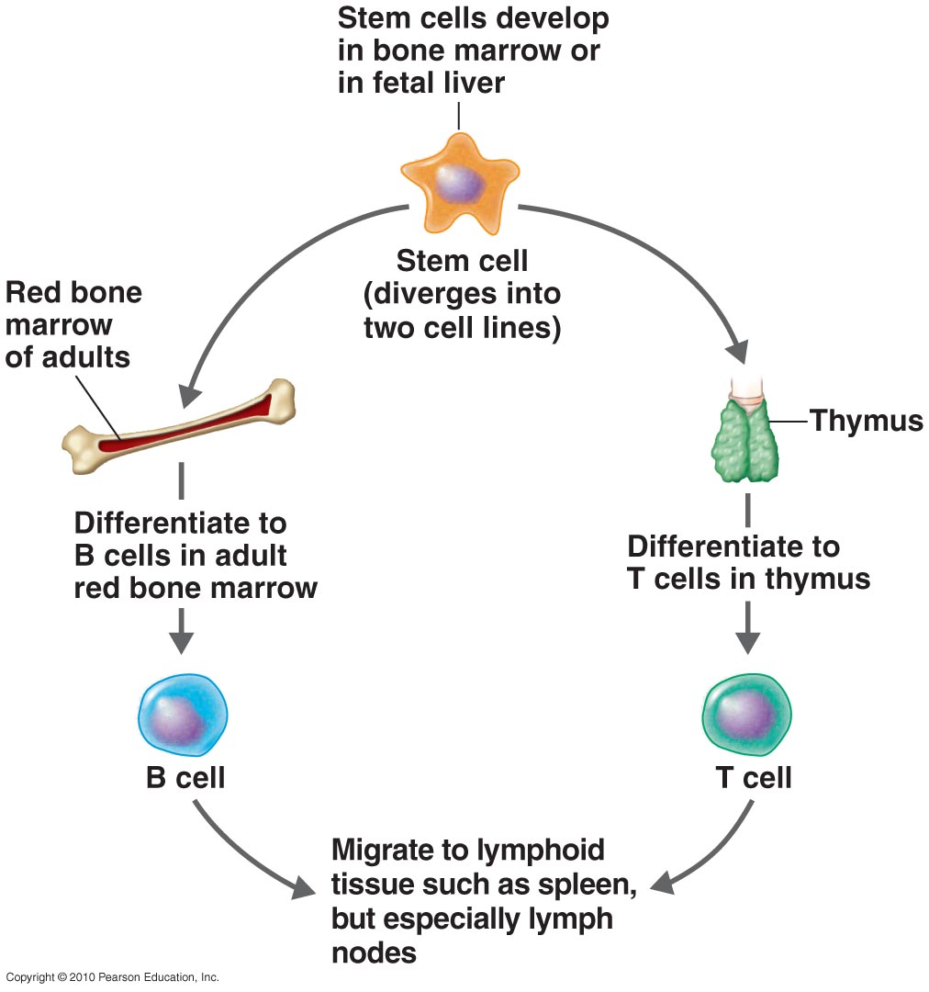
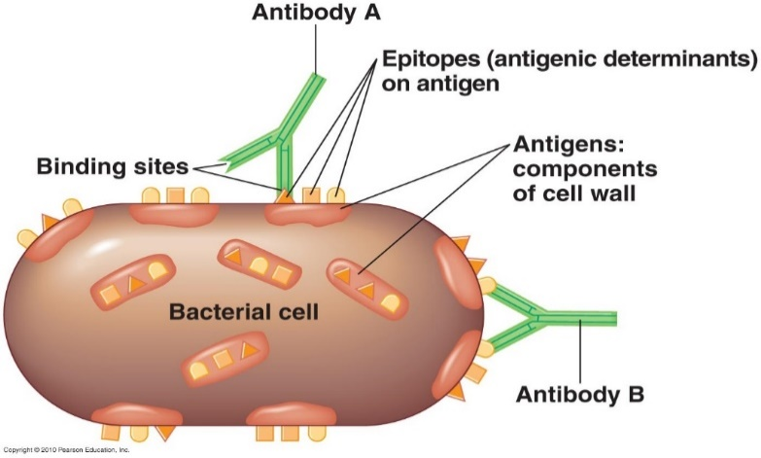
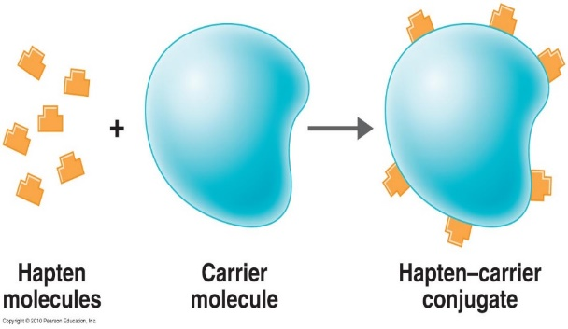
Source of B & T cells
The Nature of Antigens
Antigen (Ag): A substance that causes the body to produce specific antibodies or sensitized T cells
Antibodies (Ab) interact with epitopes or antigenic determinants
Hapten: An incomplete antigen which is not originally immunogenic.
Cannot trigger host immunity if directly binds to antibody.
Require carrier molecule to trigger the host immunity.

Slide 19
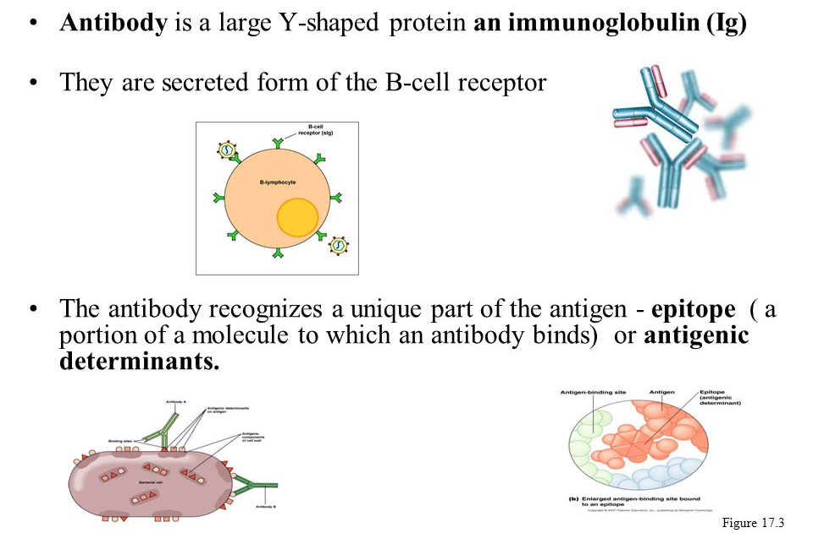
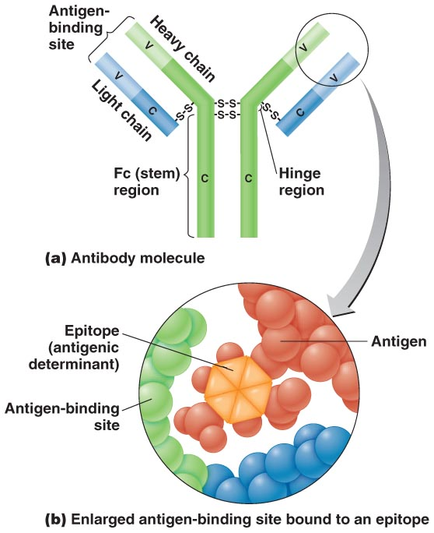
The Nature of Antibodies

Slide 20
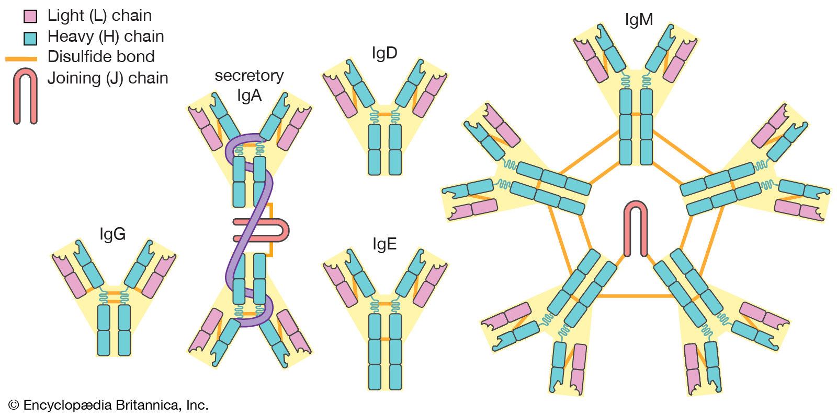
Types of Antibodies
Globular proteins called immunoglobulins
The number of antigen-binding sites determines valence
Q. Which of the antibodies has the highest valance?

Slide 21
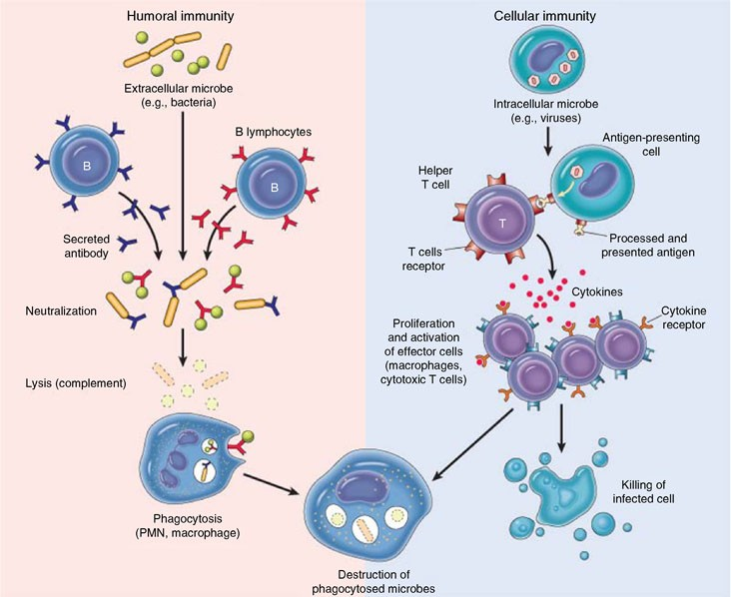
Dual Nature of Adaptive Immunity

Slide 22
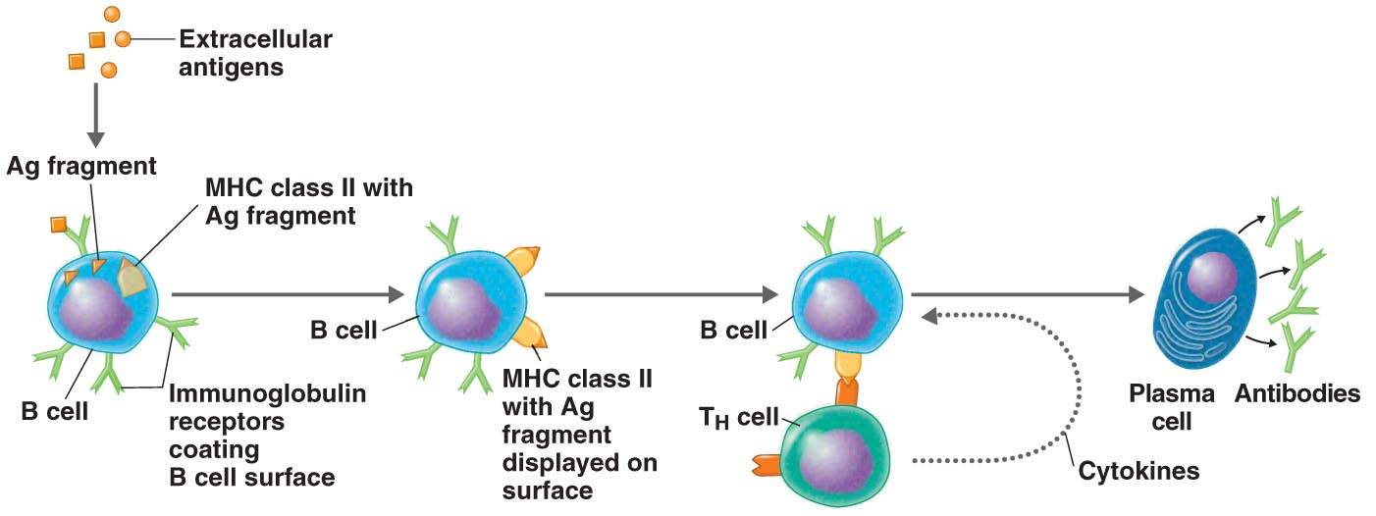
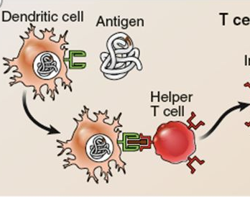
Activation of B Cells (T-dependent Antigen)

Slide 23
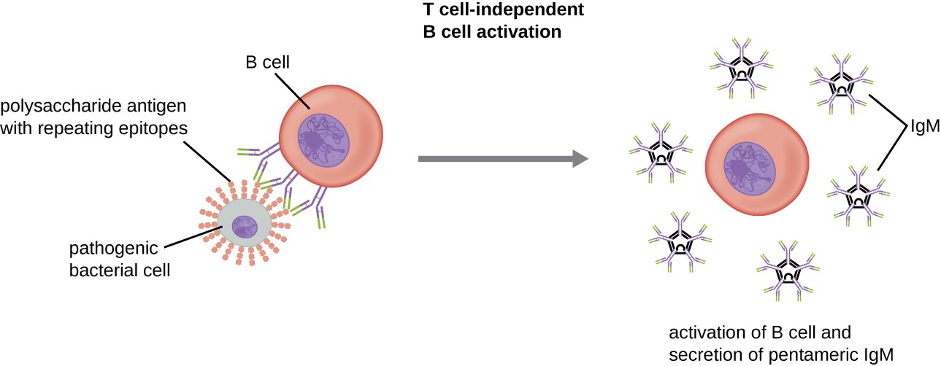
Activation of B Cells (T-independent Antigen)

Slide 24
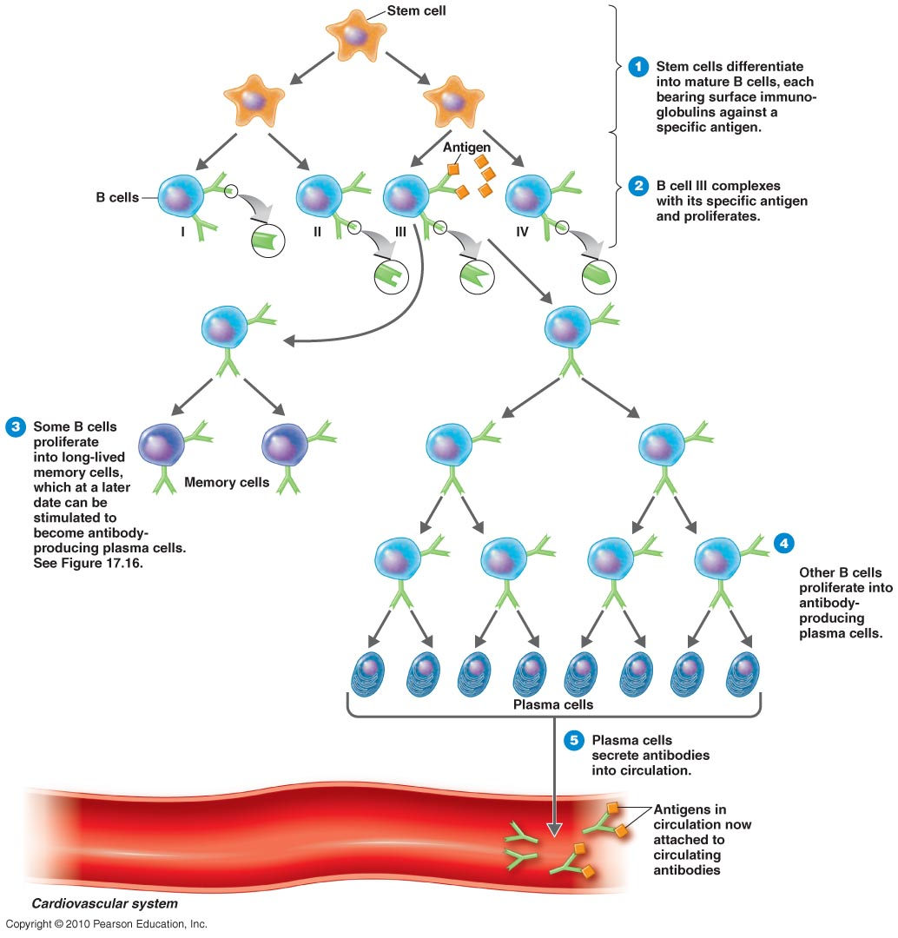
Clonal Selection

Slide 25
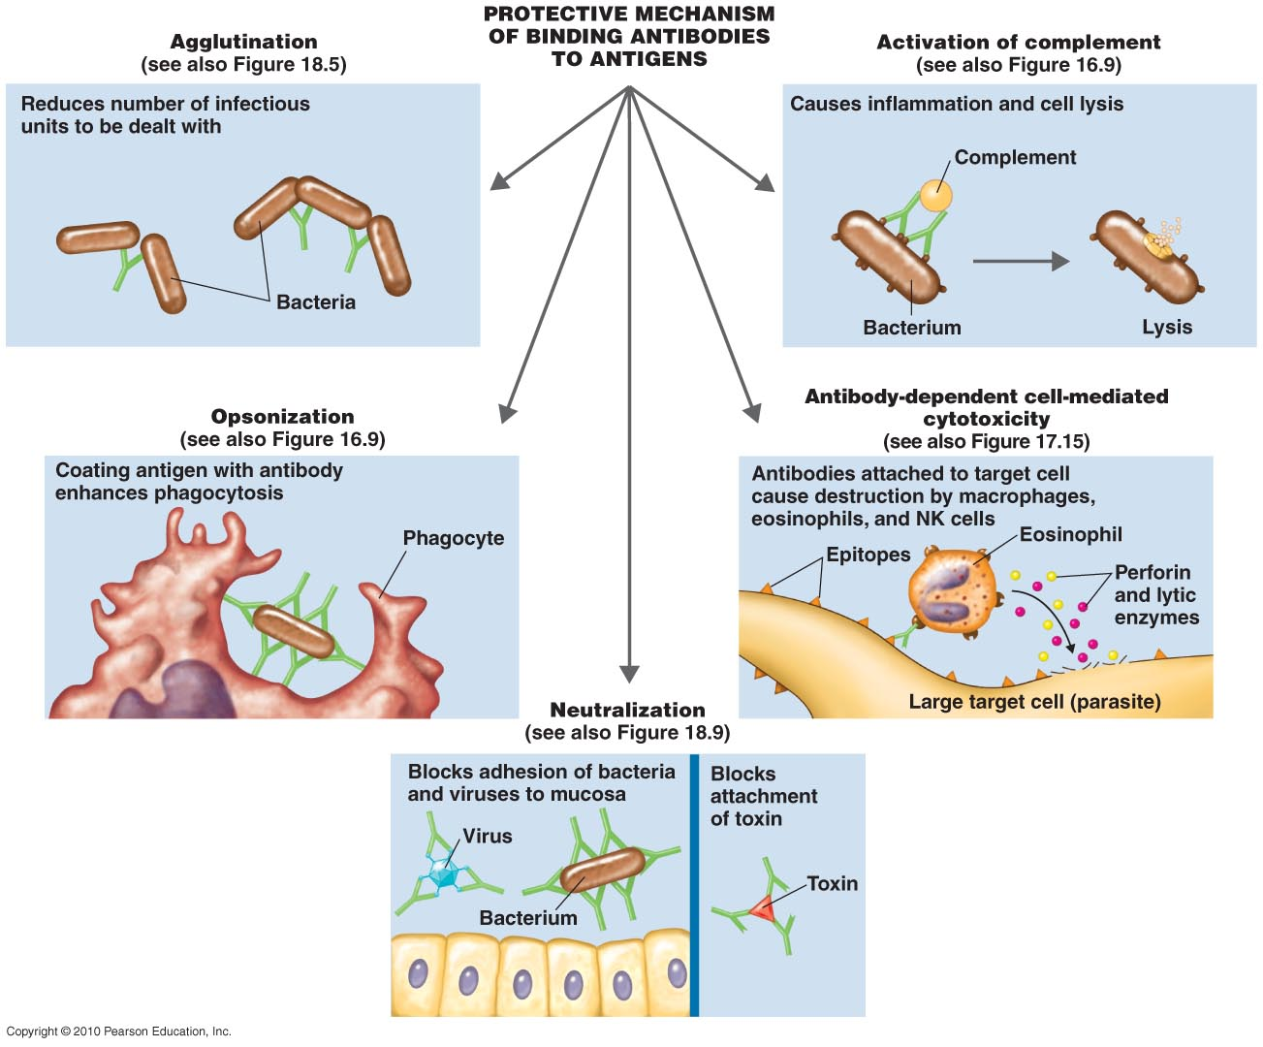
The Results of Ag-Ab Binding

Slide 26
T Cells and Cellular Immunity
T cells mature in the thymus
Thymic selection eliminates many immature T cells
T cells respond to Ag by T-cell receptors (TCRs)
T cells require antigen-presenting cells (APCs)
Pathogens entering the gastrointestinal or respiratory tracts pass through
M (microfold) cells over
Peyer’s patches, which contain APCs

Slide 27
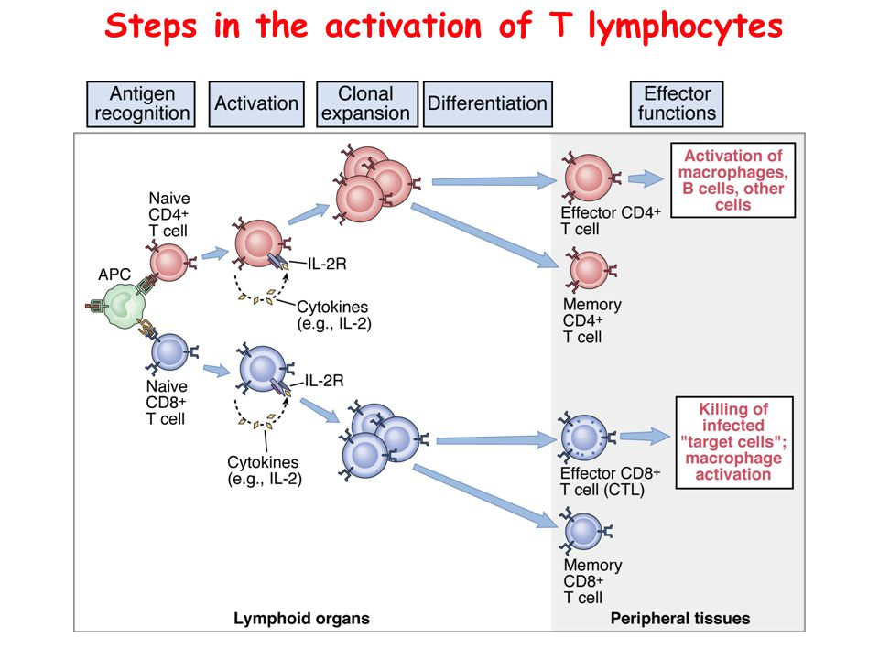
T Cell Activation

Slide 28
T Cytotoxic Cells
CD8⁺ or T_{C} cells
Target cells are self carrying endogenous antigens
Activated into cytotoxic T lymphocytes (CTLs)
CTLs recognize Ag + MHC I
Induce apoptosis in target cell

Slide 29
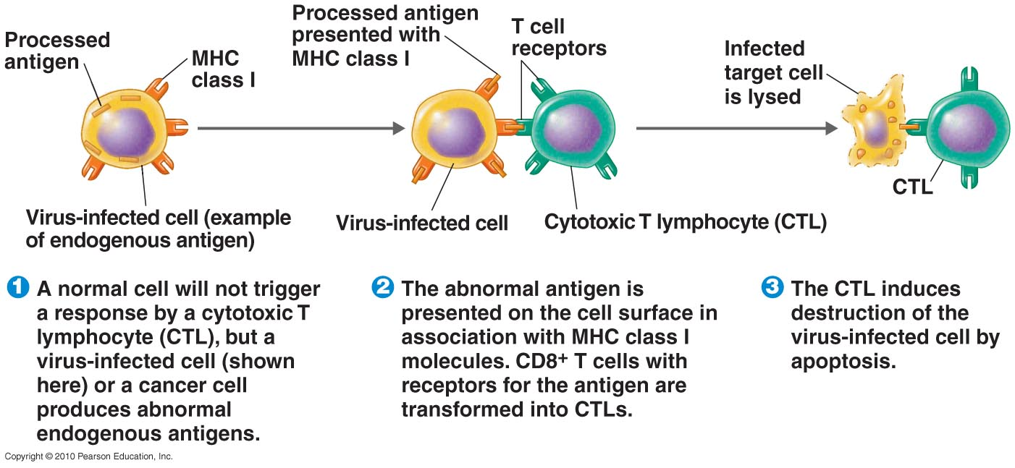
T Cytotoxic Cells

Slide 30
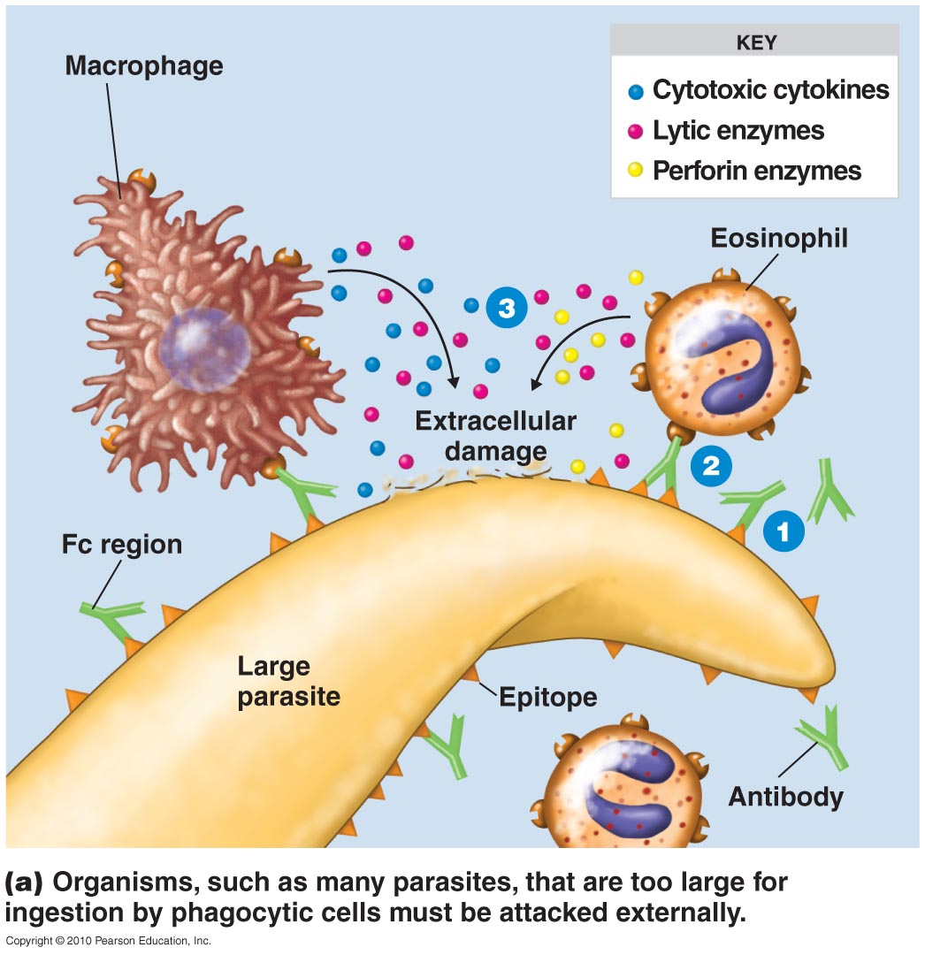
Antibody-dependent cell-mediated cytotoxicity (ADCC)

Slide 31
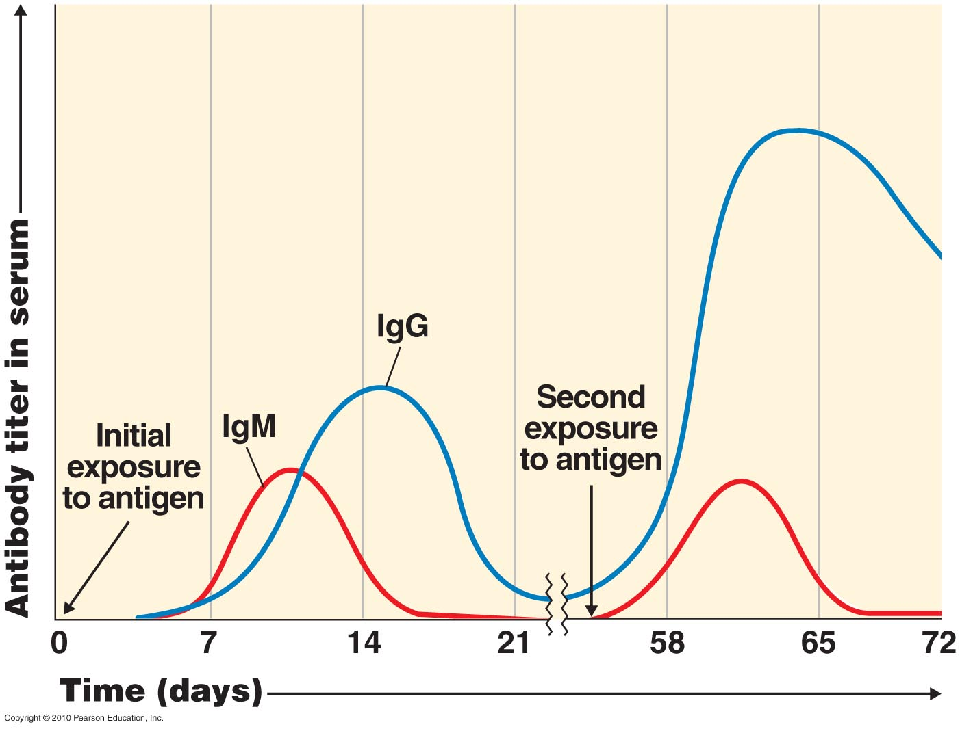
Immunological Memory
Q. Why the second or further exposure of the same pathogen is not as severe as the first time?
Antibody titer is the amount of Ab in serum
Primary response occurs after initial contact with Ag
Secondary (memory or anamnestic) response occurs after second exposure

Slide 32
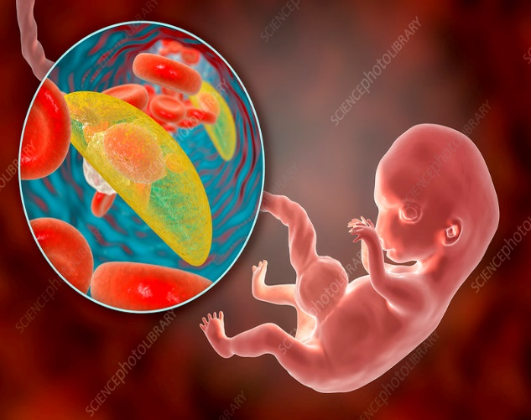
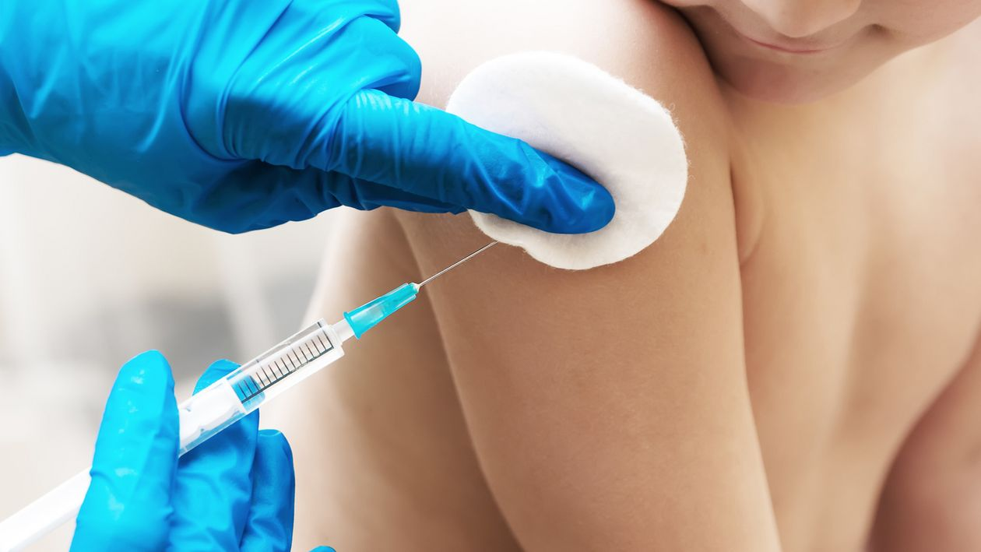
Types of Adaptive Immunity
Naturally acquired active immunity
Resulting from infection
Naturally acquired passive immunity
Transplacental or via colostrum
Artificially acquired active immunity
Injection of Ag (vaccination)
Artificially acquired passive immunity
Injection of Ab

Slide 33
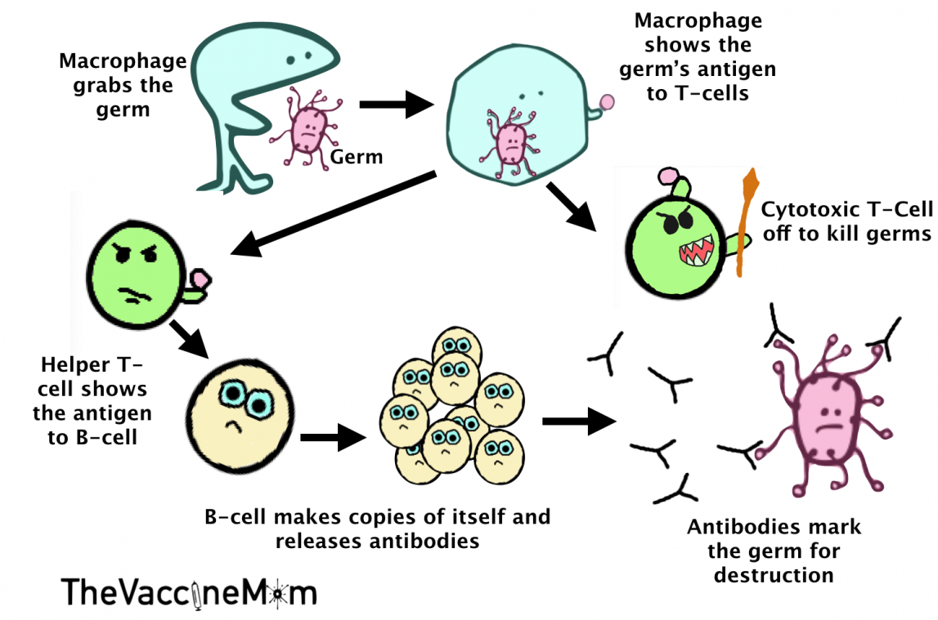
Adaptive Immune System (in a nutshell)

Slide 34
Enzymes

Slide 35
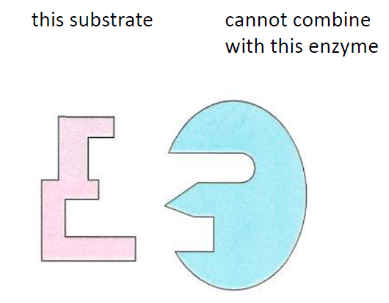
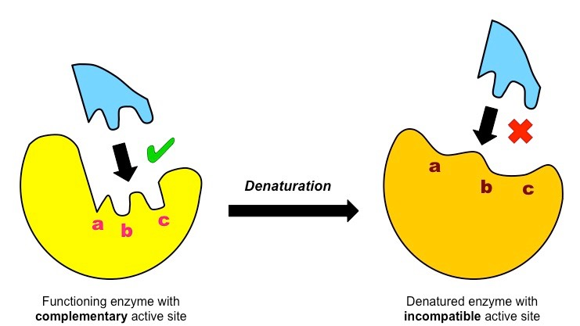
Properties of Enzymes
Enzymes are substrate specific.
The end product is always same.
At the end of the reaction, they remain unchanged.

Slide 36
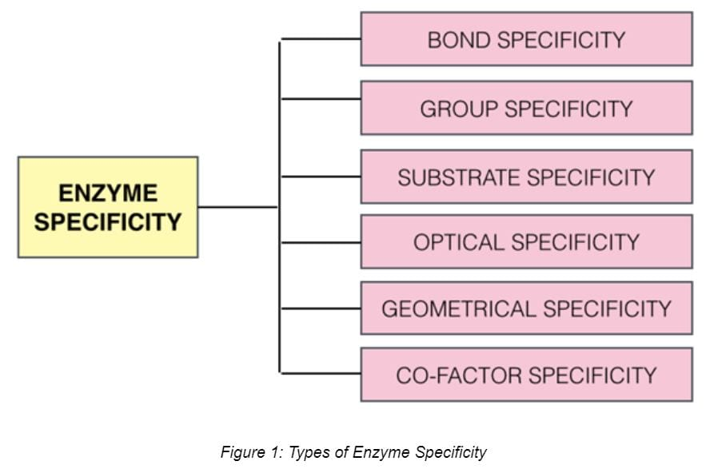
Properties of Enzymes

Slide 37
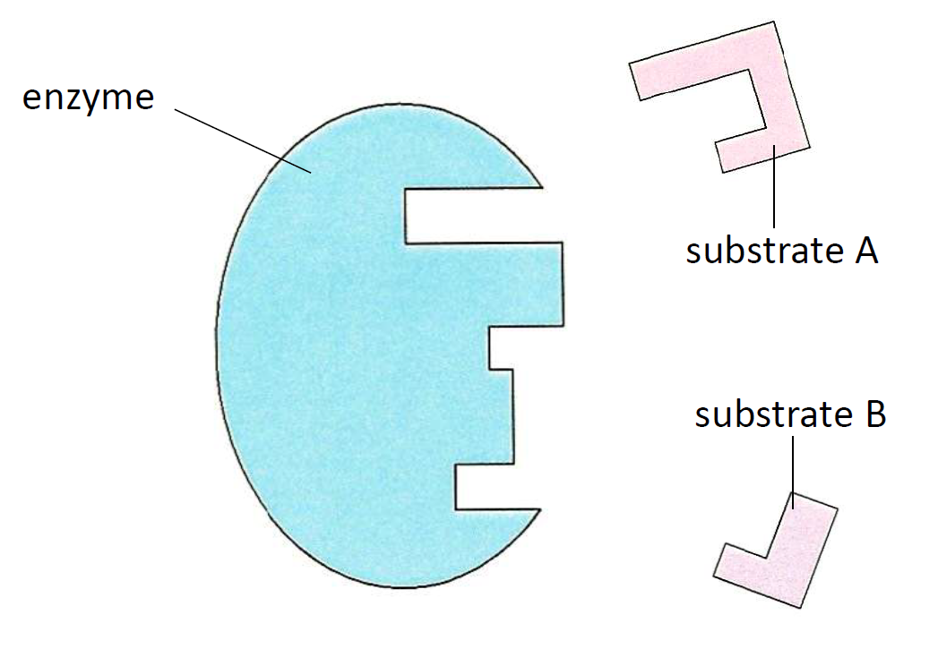
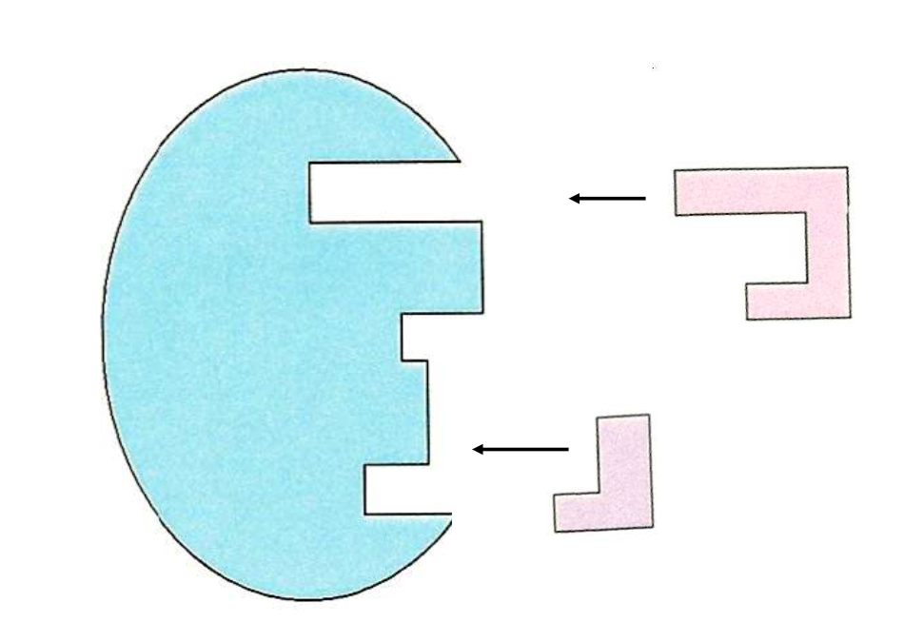
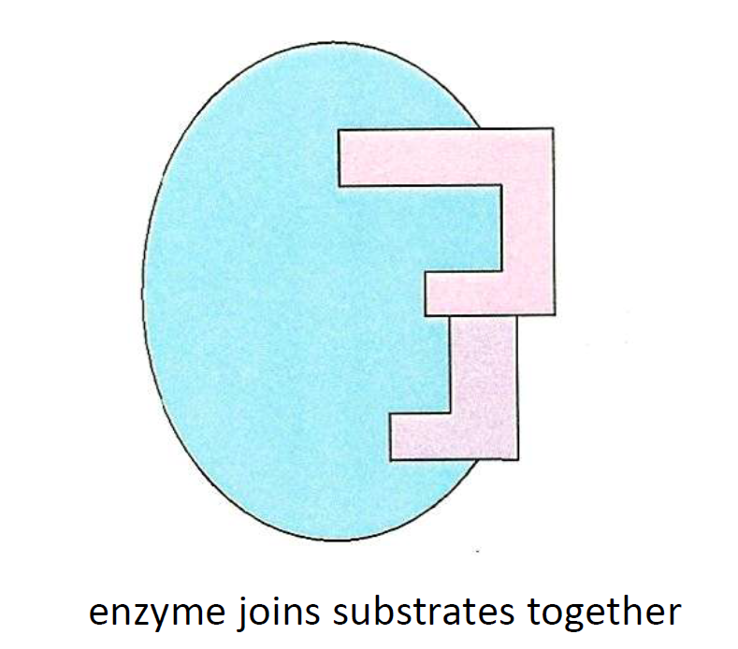
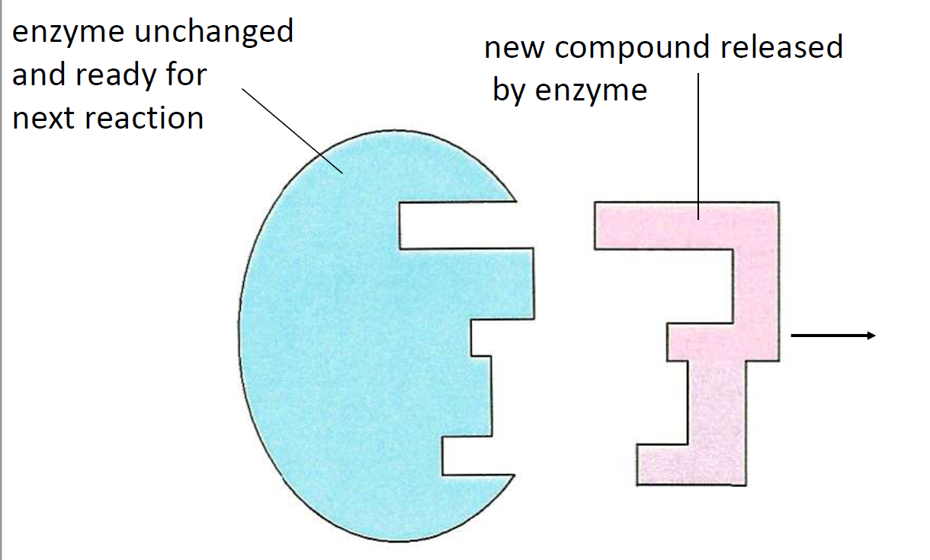
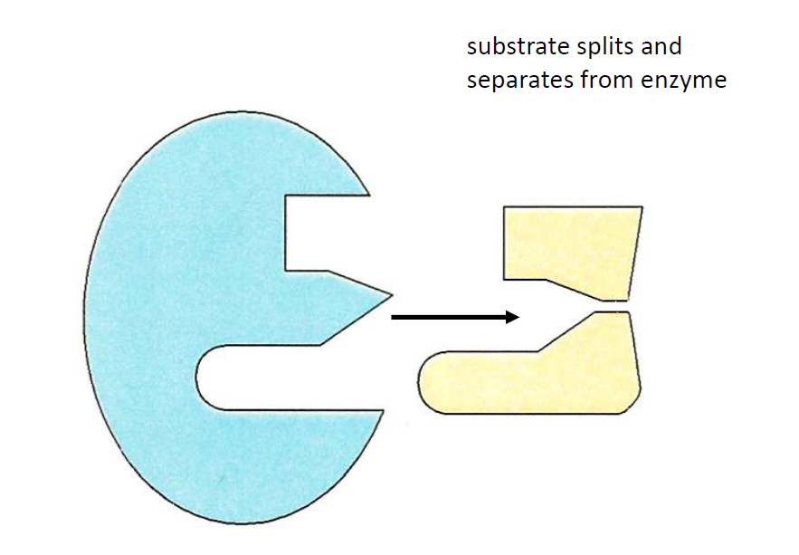
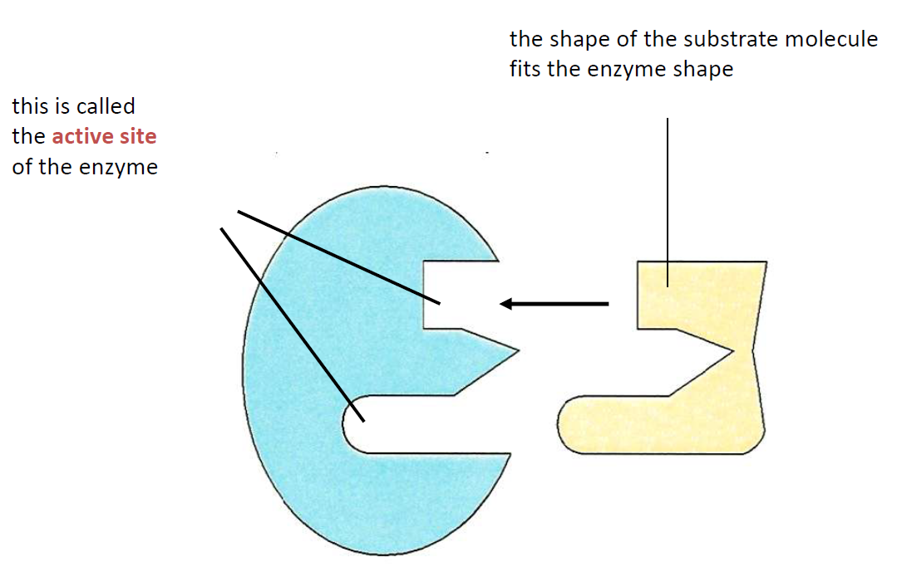
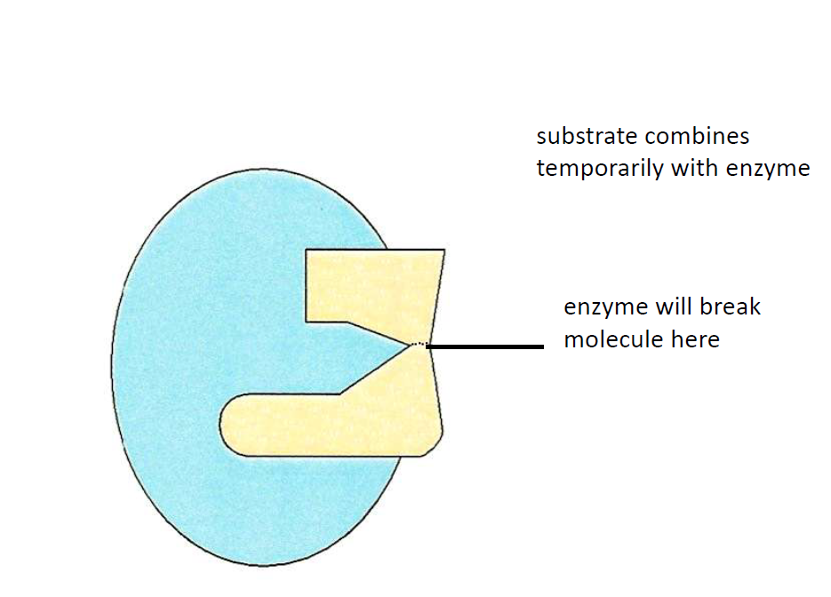
Enzymatic Reaction
Q. Why is the enzyme substrate complex is important?

Slide 38
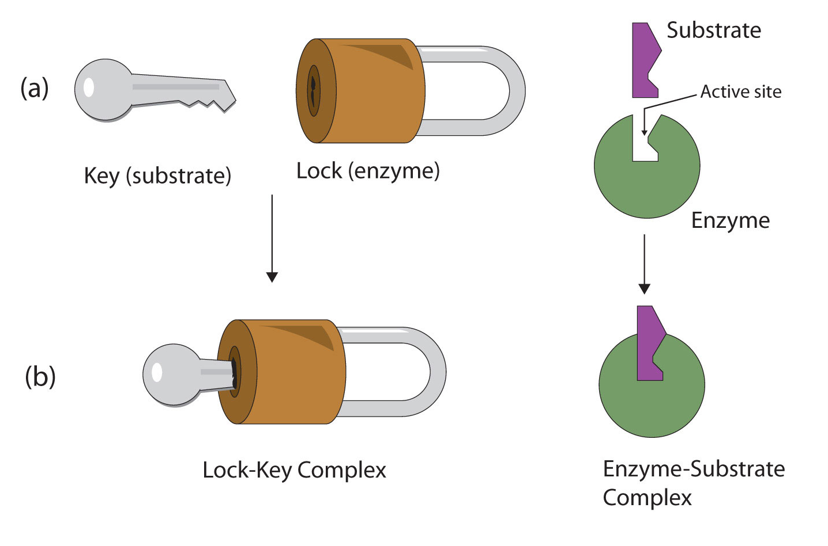
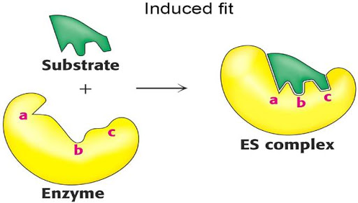
Lock & Key Model VS Induced Fit Model
Induced Fit model
Lock & Key model

Slide 39
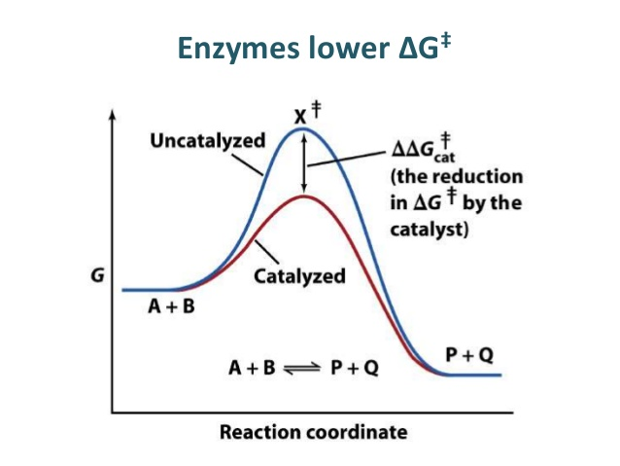
Enzyme Mechanism
Q. How does an enzyme catalyze reaction?

Slide 40
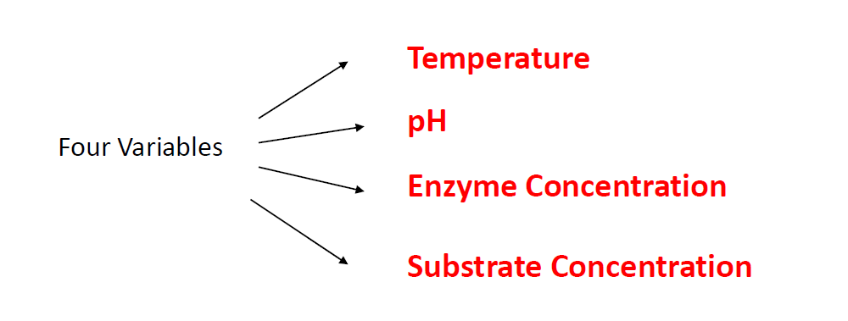
Factors Affecting Enzymatic Activity

Slide 41
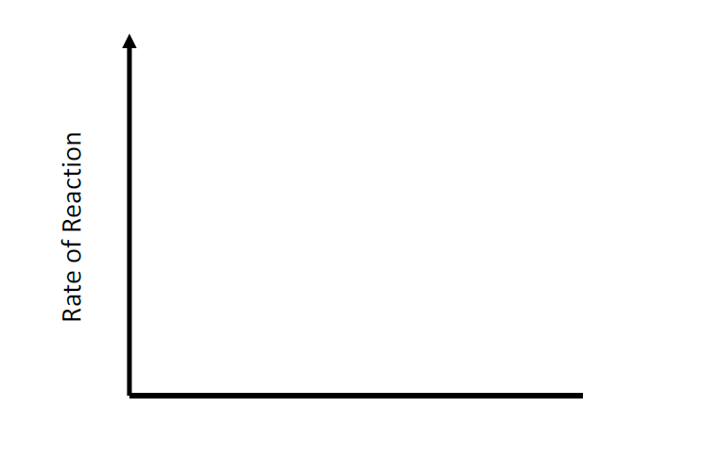
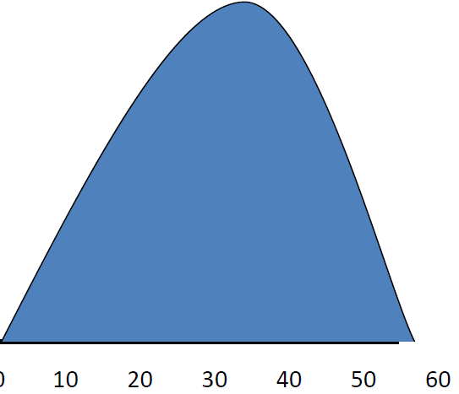
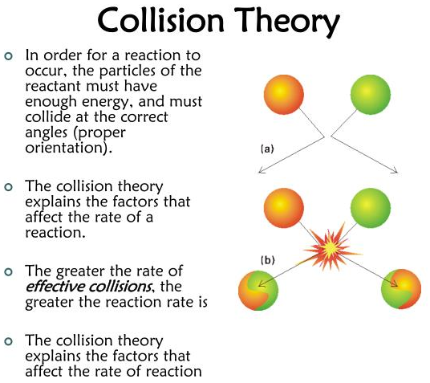
Temperature
Q. Why the same reaction require less temperature when an enzyme or a catalyst is used?
5-40°C
Increased activity
40°C
Denatures
Q. Why does increased temperature increase enzyme activity?
Q. How an enzyme is denatured at a high temperature?
<5°C
Inactive

Slide 42
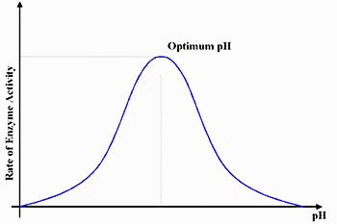
pH
Q. Why does pH denatures enzyme?

Slide 43
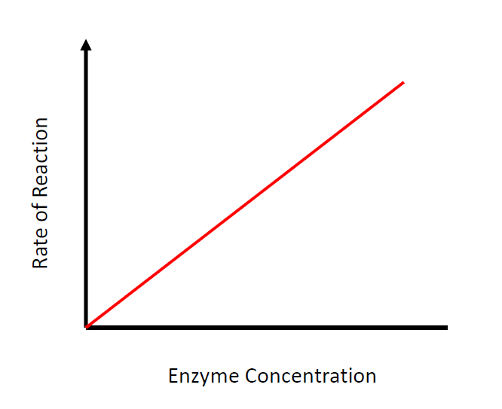

Enzyme & Substrate Concentration
Q. What happens if we increase the substrate concentration when a saturation point is reached?
Q. What happens if no variable is changed in an enzymatic reaction?

Slide 44
Enzyme Inhibition
Enzyme Inhibition
Reversible
Irreversible
Competitive
Non Competitive
Feedback/End product

Slide 45

Reversible Inhibition
Q. On what the competitive inhibition depends?

Slide 46

Irreversible Inhibition

Slide 47


Nucleic Acid
A complex organic substance present in living cells, especially DNA or RNA, whose molecules consist of many nucleotides linked in a long chain.

Slide 48


Nucleotide Bases
Q. Which site of the DNA is more susceptible to mutation? Why?

Slide 49
DNA Replication

Slide 50




Key Machineries for Replication
DNA Polymerase
DNA Helicase
An Enzyme.
Separation of two strands.
An Enzyme
Builds the complementary strand
DNA Ligase
Primer
A short (22-35 bp) nucleic acid sequence (RNA).
A primer is required to start the replication
An Enzyme.
Joining of 3’ & 5’ end of a DNA strand.

Slide 51


DNA Replication

Slide 52

Leading & Lagging Strand

Slide 53

Okazaki Fragment

Slide 54


Slide 55


Transcription Unit
Enhancer:
A short segment of DNA (~50-1500 bp)
It can be anywhere on the DNA, not necessarily it has to be near to the promoter.
Transcription factors bind to enhancers.

Slide 56


Different Stages of Transcription
4 stages
Recognition and binding
Initiation
Elongation
Termination and release
Q. Why introns are removed from RNA transcript?

Slide 57

Translation

Slide 58


Ribosome & tRNA

Slide 59


Codon

Slide 60


Translation

Slide 61

Start & End of translation
Q. Translation starts from which codon?
(Amino group exposed)
(Carboxyl group exposed)
Q. What happens if a stop codon is found in an mRNA?

Slide 62

Reading Frame

Slide 63

Gene expression regulation:
Both of these cells contain the same genome, but they express different RNAs and proteins.
Two possible reasons :
Gene regulation
Mutation

Slide 64


Slide 65

Lac Operon Model

Slide 66
Mutation

Slide 67
Types of Mutations
Mutation
Chromosome Mutation
Deletion
Inversion
Gene Mutation
Substitution
Duplication
Translocation
Nondisjunction
Point Mutation
Deletion
Insertion
Frameshift Mutation

Slide 68

Chromosome Mutations
May Involve:
Changing the structure of a chromosome
The loss or gain of part of a chromosome

Slide 69



Deletion
Inversion
Duplication
Due to breakage
A piece of a chromosome is lost
Occurs when a gene sequence is repeated
Chromosome segment breaks off
Segment flips around backwards
Segment reattaches

Slide 70


Slide 71

Translocation
Involves two chromosomes that aren’t homologous
Part of one chromosome is transferred to another chromosomes

Slide 72

Nondisjunction
Failure of chromosomes to separate during meiosis
Causes gamete to have too many or too few chromosomes

Slide 73
Gene Mutations

Slide 74

Point Mutation
Change of a single nucleotide
Includes the deletion, insertion, or substitution of ONE nucleotide in a gene

Slide 75

Frame Shift Mutation

Slide 76

Point Mutation

Slide 77
THANK YOU

